Slide 1
MINOR PROJECT
Team no : 65
- Under the guidance of Dr. P. Baby Maruthi
Team members:
Bharath Kumar N – ENG19CS0064
Chandrashekar V – ENG19CS0070
Chethan BS – ENG19CS0074
Chethan R – ENG19CS0075
Chethan Rao S – ENG19CS0076

Slide 2

AI BASED VIRTUAL MOUSE
TOPIC:

Slide 3
TABLE OF CONTENTS
01
Implementation of project
02
Demonstration of project
03
Testing
04
Conclusion

Slide 4
Implementation

Slide 5
Implementation:
The project is divided into 2 sub-programs which is stored in 2 separate files:
Hand Tracking Module
AI Virtual Mouse Module
1. Hand Tracking Module :
The framework used is Mediapipe developed by google.
It uses two main models ,
Palm detection
hand landmarks

Slide 6
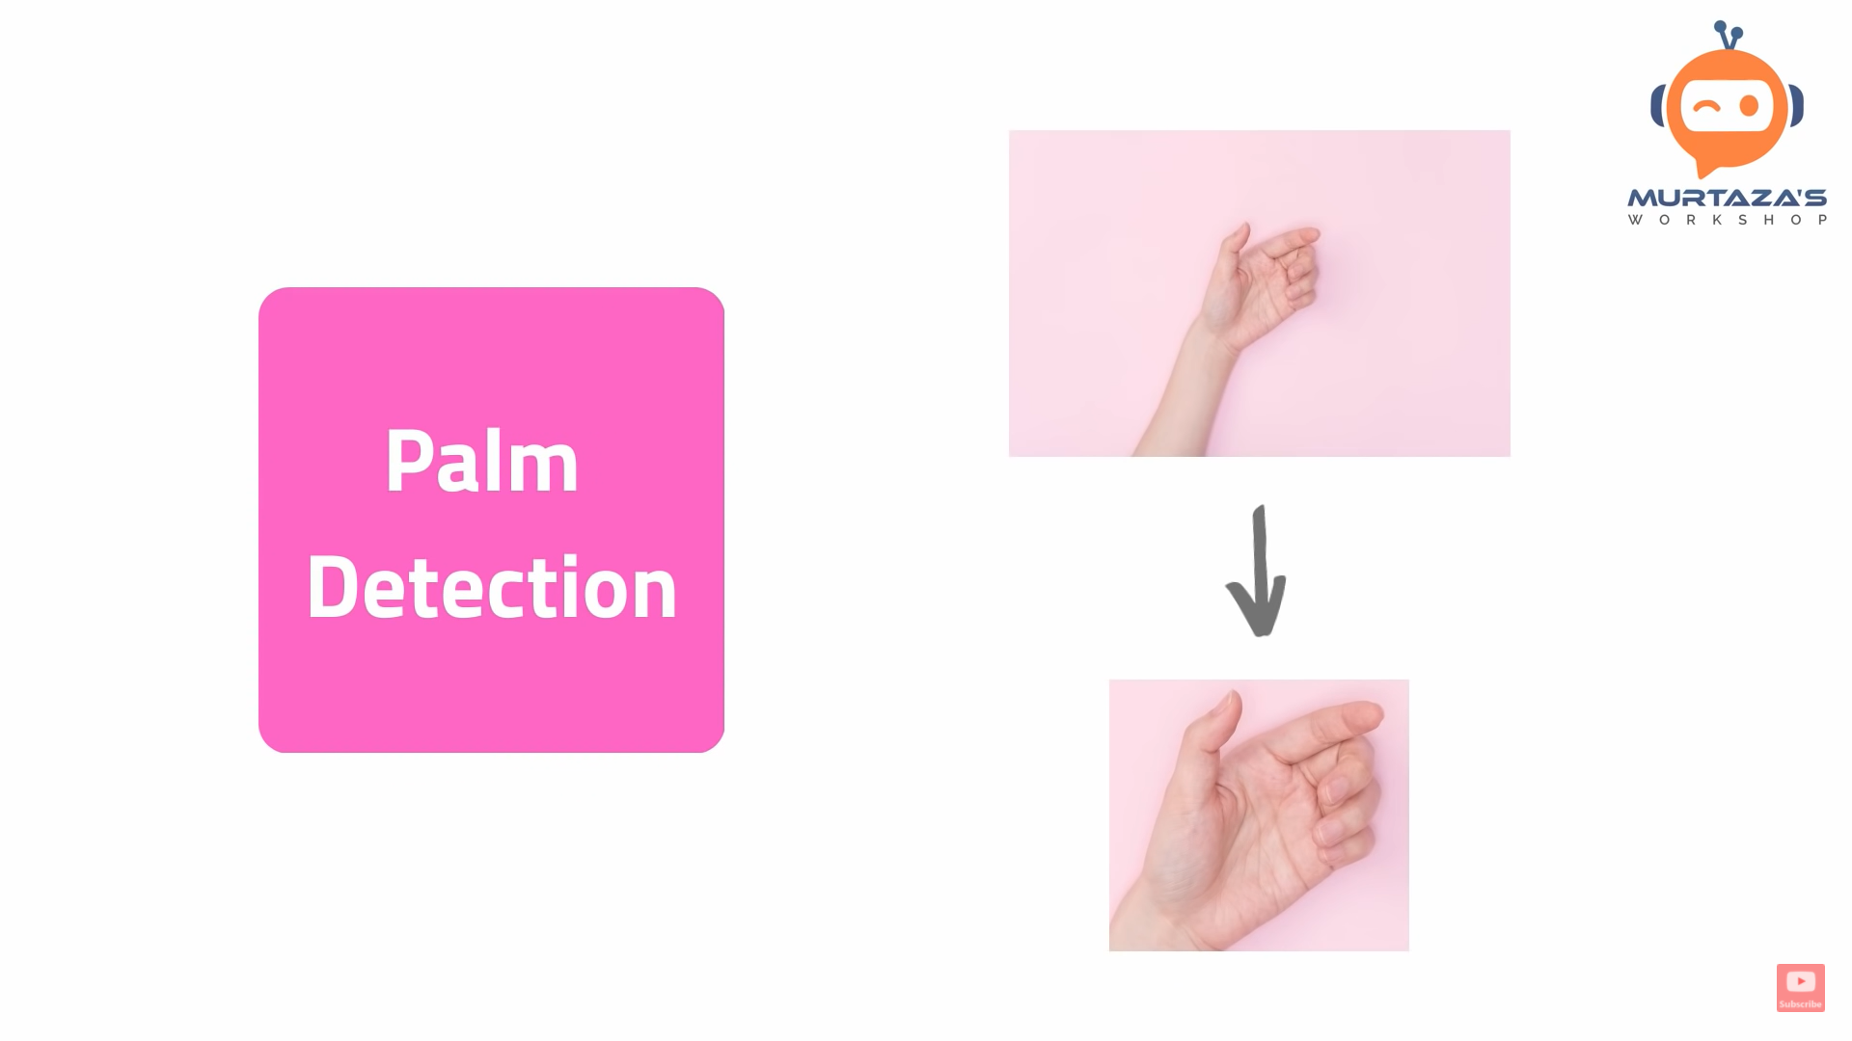
I. Palm Detection Model :
To detect initial hand locations, they designed a single-shot detector model optimized for mobile real-time uses.
Detecting hands is a decidedly complex task: their model has to work across a variety of hand sizes with a large scale span (~20x) relative to the image frame and be able to detect occluded and self-occluded hands.

Slide 7

II. Hand Landmark Model :
After the palm detection over the whole image our subsequent hand landmark model performs precise key point localization of 21 3D hand-knuckle coordinates inside the detected hand regions via regression, that is direct coordinate prediction.
The model learns a consistent internal hand pose representation and is robust even to partially visible hands and self-occlusions.

Slide 8
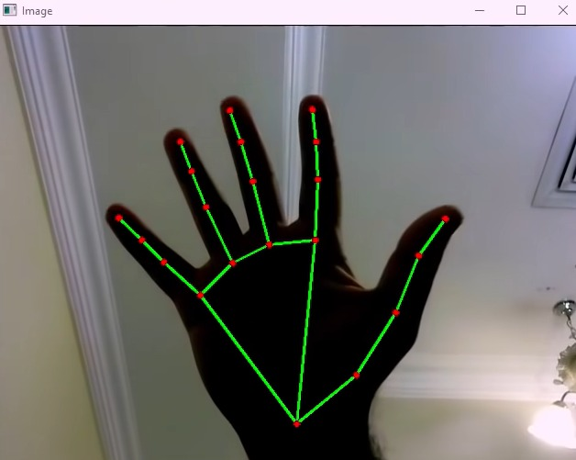
Steps in hand tracking module are :
i) Find Hands :
Converts captured image into RGB and send it to the mediapipe hands object to detect the hand.

Slide 9
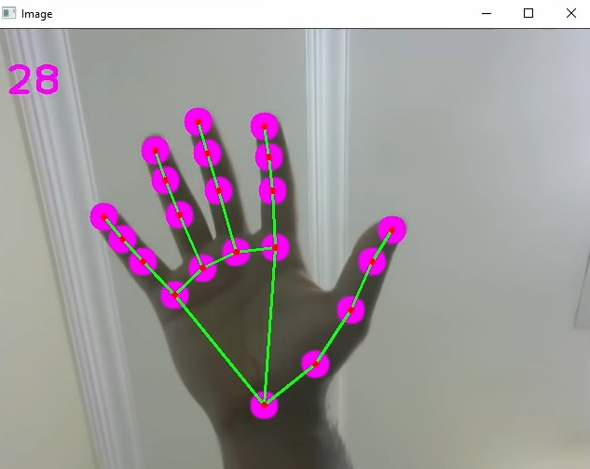
ii) Find Position :
Finding the position of all 21 landmarks and storing it in a list so that we can make use of it.

Slide 10
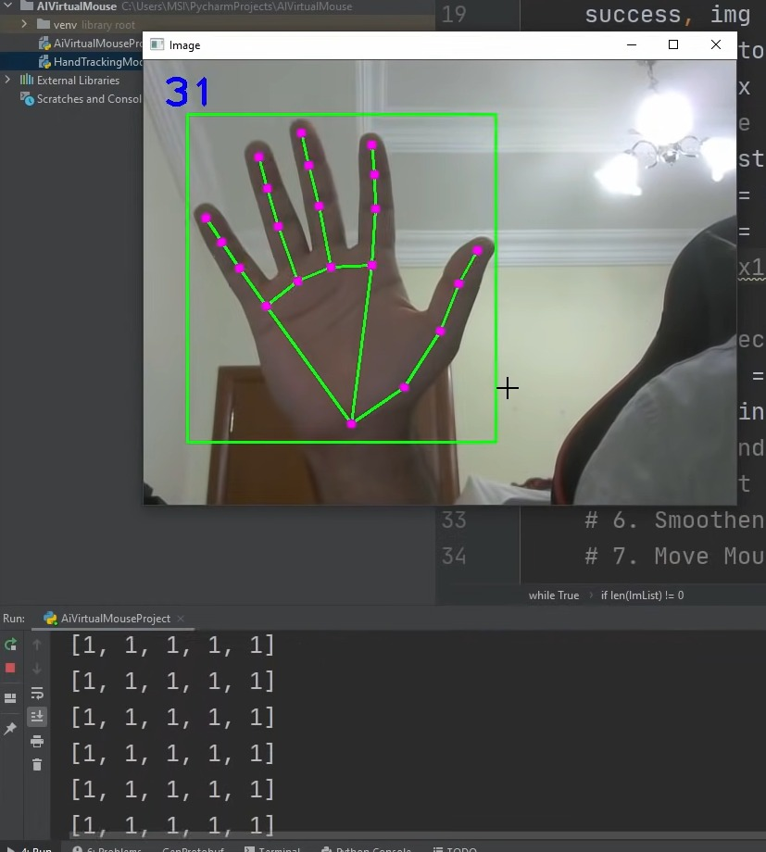
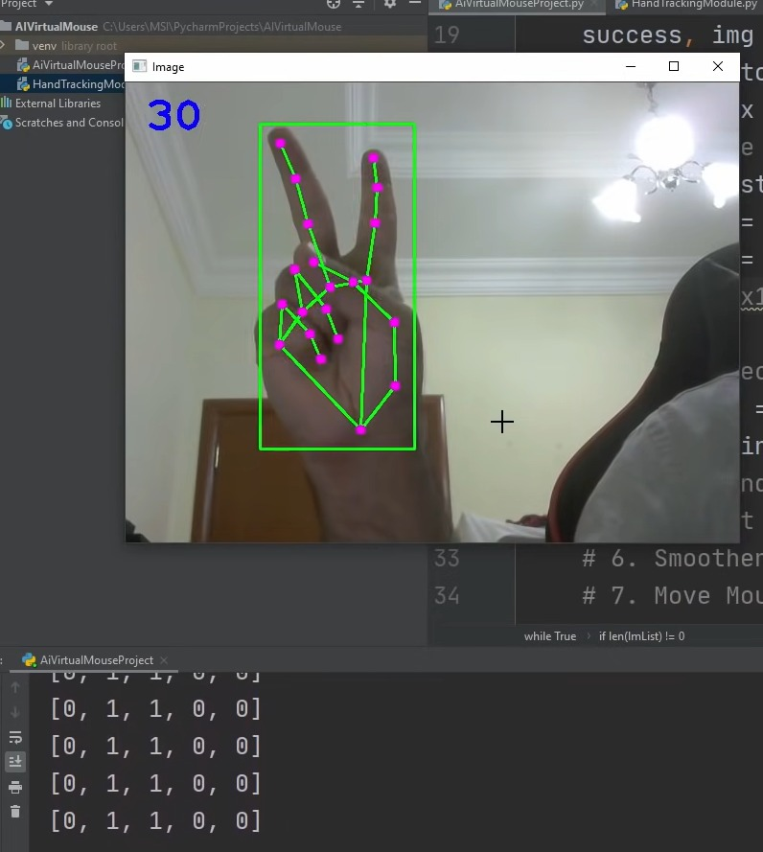
iii) Fingers Up:
Detecting which fingers are up.

Slide 11
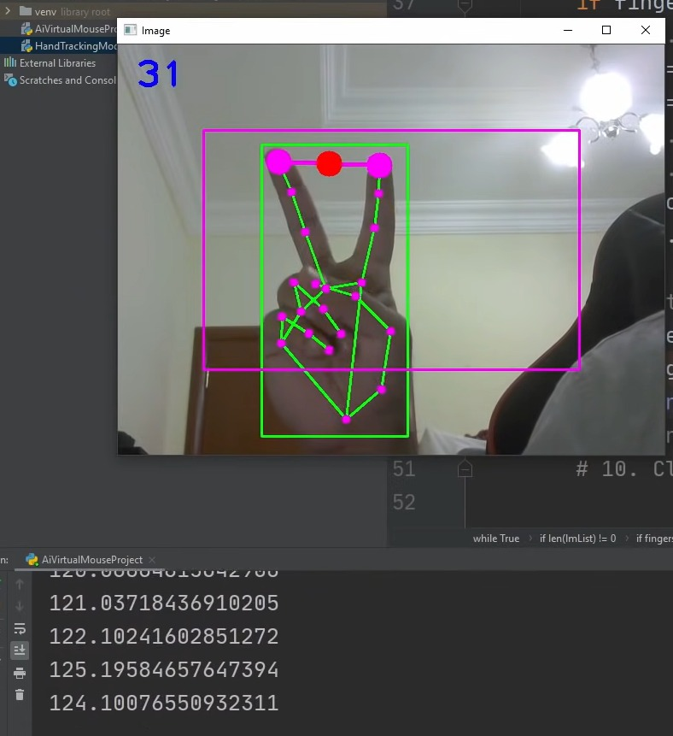
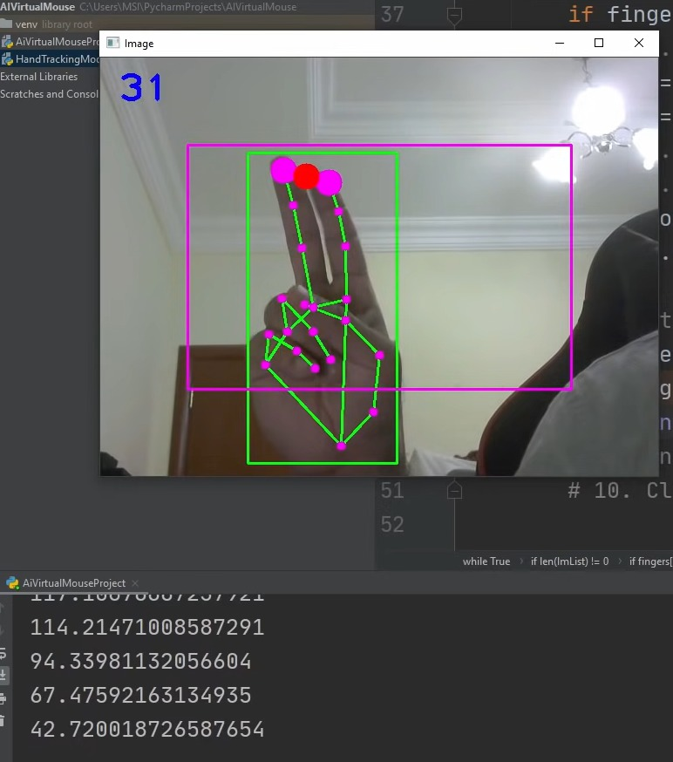
iv) Find Distance :
Finding the distance between any two fingers.

Slide 12
2. AI Virtual Mouse Module :
Find hand Landmarks.
Check which fingers are up.
Only Index finger: Moving Mode.
Convert Coordinates.
Smoothen Values.
Move Mouse.
Both Index and middle fingers are up : Left click Mode.
Find distance between fingers.
Click mouse if distance short.
Both Index and thumb up: Scroll
All five fingers are up : right click mode
Frame rate.
Display.

Slide 13
OPERATION | GESTURES
1. Move curser | Index finger (up)
2. Left click | Index & Middle finger (up & closer)
3. Right click | All 5 fingers (up)
4. Scrolling | Thumb & index finger (up & closer)

Slide 14
Demonstration

Slide 15
Testing

Slide 16
CURSER OPERATION:
Failed Testcase
Passed Testcase

Slide 17
LEFT CLICK OPERATION:
Failed Testcase
Passed Testcase

Slide 18
RIGTH CLICK OPERATION:
Failed Testcase
Passed Testcase

Slide 19
SCROLLING OPERATION:
Failed Testcase
Passed Testcase

Slide 20
Conclusion

Slide 21
The main objective of the AI virtual mouse system is to control the mouse cursor functions by using the hand gestures instead of using a physical mouse.
The proposed system can be achieved by using a webcam or a built-in camera which detects the hand gestures and hand tip and processes these frames to perform the particular mouse functions.
From the results of the model, we can come to a conclusion that the proposed AI virtual mouse system has performed very well and has a greater accuracy compared to the existing models and also the model overcomes most of the limitations of the existing systems.
Since the proposed model has greater accuracy, the AI virtual mouse can be used for real-world applications, since the proposed mouse system can be used virtually using hand gestures without using the traditional physical mouse.

Slide 22
https://github.com/ENG19CS0070chandrashekar/AI-BASED-VIRTUAL-MOUSE
GITHUB PROJECT LINK:

Slide 23
Thank you..

